Slide 1

CSE413 – Security of Information Systems 2020 PhD Furkan Gözükara, Toros University https://github.com/FurkanGozukara/Security-of-Information-Systems-CSE413-2020
Lecture 2
Information Security Management and Human Factors for Information Security
Composed from Prof. Audun Jøsang, University of Oslo, Information Security 2018 Lectures

Slide 2
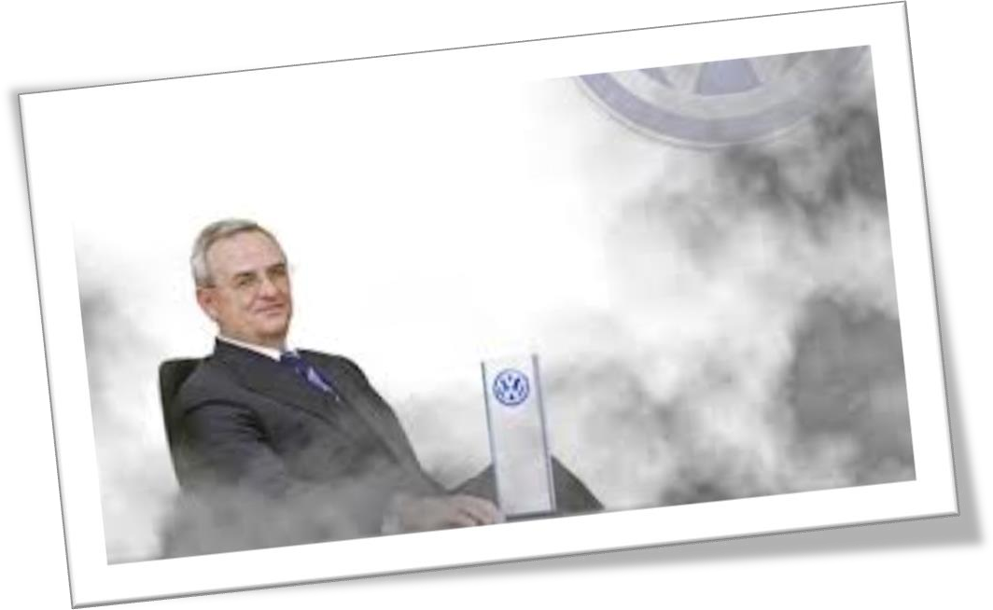

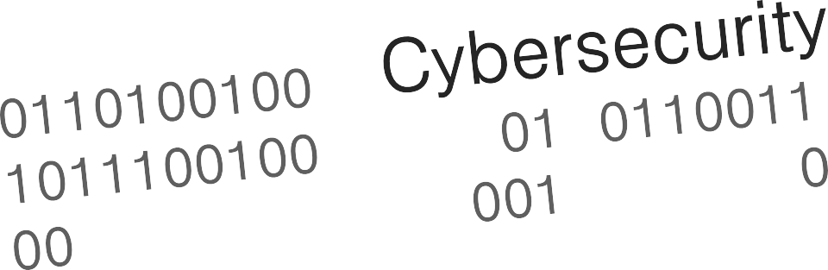
Corporate Responsibilities

Slide 3
Security Management Levels
Set enterprise
objectives.
Balance stakeholder value propositions.
Information Security Governance
Information Security Management
Achieve enterprise objectives
IT Security Operations

Slide 4
Information Security Governance
IS governance provides strategic direction, ensures objectives are achieved, manages risk appropriately, uses organizational resources responsibly, and monitors the success or failure of the enterprise security programme.
- IT Governance Institute
Security
Governance

Slide 5




Benefits of IT Security Governance
Protecting assets = creating value
Trust from customers, partners, investors, own staff
Reputation, brand, image
Competitive advantage
Prevention and reduction of losses
Business continuity & resilience
– In case of disasters and major incidents
Increase shareholder value
Security
Governance

Slide 6
Goals of information security governance as defined by COBIT and ISACA
Strategic alignment of security program
Risk management
Value delivery
Resource management
Performance measurement
http://www.isaca.org/knowledge-center/research/documents/information-security-govenance-for-board-of-directors-and-executive-management_res_eng_0510.pdf
Security
Governance

Slide 7
Characteristics of good IS Governance
Managed as a business-wide issue
Alignment of frameworks, policies and activities
Viewed as business requirement
Seen as essential for sustainable business operations
Leaders are informed
Visible leaders who understand risks and get regular reviews
Leaders take responsibility
Leaders set clear goals and priorities
Risk-based priorities
Tolerances to risk understood and established
Roles & responsibilities defined
Clear segregation of duties
Security
Governance

Slide 8
Information security management
Includes:
Risk management and reporting
Development and maintenance of security policies
Documented goals, rules and practice for IS
Planning and organisation of the security activities
Information Security Management System (ISMS)
Information classification
Integration of security procedures, standards & guidelines
Deployment and maintenance of security controls
Security education and training
Disaster recovery and business continuity planning
Coordination with top level management
Security
Management

Slide 9


IS Management Standards
ISO/IEC 27K security standards:
ISO: International Standards Organization
ISO 27001: Information Security Management System (ISMS)
ISO 27002: Code of practice for information security controls
– + many more
ISO/IEC standards cost money
USA
NIST (National Institute for Standards and Technology) Special
Publications 800 ,
Cover similar topics as ISO27K
NIST standards are free

Slide 10

Evolution of ISO 27001 & 27002 Standards
1995
BS 7799 Code of Practice for
Information Security Management
1999
BS 7799-2 Information Security
Management System (ISMS)
2005
ISO/IEC 17799
ISO/IEC 27001
ISO/IEC 17799-2
ISO/IEC 27002
2013
ISO Management Standards Alignment
ISO/IEC 27001 ISMS
ISO/IEC 27002 Code of Practice for Information Security Controls
2017
Latest update, minor changes
2001
BS 7799
BS 7799-2
→ ISO/IEC 17799
→ ISO/IEC 17799-2

Slide 11
ISO/IEC 27000 family of standards and related standards
as of Oct. 2013
Vocabulary
Guide
Overview and vocabulary
Code of practice
27000
27002
27016
Organizational economics
Principles and guidelines
31000
27005
Requirements
27001
27014
Governance
Risk assessment techniques
31010
Risk Management
27003
Implementation guidance
Conformity Assessment –
Vocabulary and general principals
17000
17021 27006
Certification
27004
Measurements
Requirements for bodies audit and certification
Application areas
Conformity assessment
19011
Guidelines for auditing management system
27010
Inter-sector and Inter organizational
Telecommunications
27007
Guidelines for ISMS auditing
27011
27008
Guidance for auditors on controls - TR
27001+20000-1
27013
Operation
27015
Financial services
Business Continuity
27031
27032
Cyber Security
27017
Cloud Computing service
Network Security
27033
27018
Data protection control of public cloud computing service
Application Security
27034
27035
27019
Process control system - TR
Incident Management
Digital Evidence Mgmt
27799
Health
27037

Slide 12
ISO/IEC 27002– What is it?
Code of practice for information security controls
ISO 27002 provides a checklist of general security controls to be considered implemented/used in organizations
Contains 14 categories (control objectives) of security controls
Each category contains a set of security controls
In total, the standard describes 113 generic security controls
Not all controls are relevant to every organisation
Objective of ISO 27002:
“… gives guidelines for […] information security management practices including the selection, implementation and management of controls taking into consideration the organization’s information security risk environment(s).”

Slide 13













The 14 Control Objectives of ISO/IEC 27002:2013
Information
Compliance
security policy
Security Organization
Business
continuity
Human resources security
Incident management
Asset
management
Security
Controls
Supplier relationships
Access
control
System acq., develop. & maint.
Cryptography
Physical and environmental security
Communications security
Operations

Slide 14
ISO/IEC 27001:2013- What is it?
ISO 27001 specifies requirements for establishing, implementing, maintaining and continually improving an information security management system (ISMS) within the context of the organization.
ISMS is a holistic approach to IS management
… not an IT system
While the ISO 27002 (code of practice) defines a set of security goals and controls, ISO 27001 (ISMS) defines how to manage the implementation of security controls.
Organizations can be certified against ISO 27001
… but not against ISO 27002
ISO 27001 is to be used in conjunction with ISO 27002

Slide 15

IS Management System Cycle
IS management cycle as an interpretation of ISMS (ISO 27001).
Source: NSM (Nasjonal Sikkerhets- myndighet).
Planning
Risk Assessment
Reporting
ISMS Cycle
The steps in the cycle can be performed in parallel.
Good IS management requires that all steps are implemented by the organisation
Evaluation
Security Controls

Slide 16
CISSP 7th Ed. IS Program Phases
CISSP 7th Ed. (p.41) IS program phases | Description
1. Plan and organise | Establish mgmt commitment and high level IS policy Define roles and committees, Assess threats, vulnerabilities and risk Identify and plan security solutions and controls
2. Implement | Assign roles and responsibilities Develop specific IS policies and procedures Implement security solutions and controls
3. Operate and maintain | Execute security operations tasks Carry out internal and external audit Develop monitoring and metrics for security controls
4. Monitor and evaluate | Review audits, monitoring and metrics Assess goal accomplishment Identify areas for improvement, and integrate in phase 1.

Slide 17

20 CSC: Critical Security Controls
20 essential security controls
https://www.cisecurity.org/controls/
Description of each control:
Why control is critical
How to implement controls
Specific tasks
Procedures and tools
Advice on implementation
Effectiveness metrics
Automation metrics
How to automate effectiveness metrics
Effectiveness tests
System entity relationship diagram
Relevant architecture integration

Slide 18
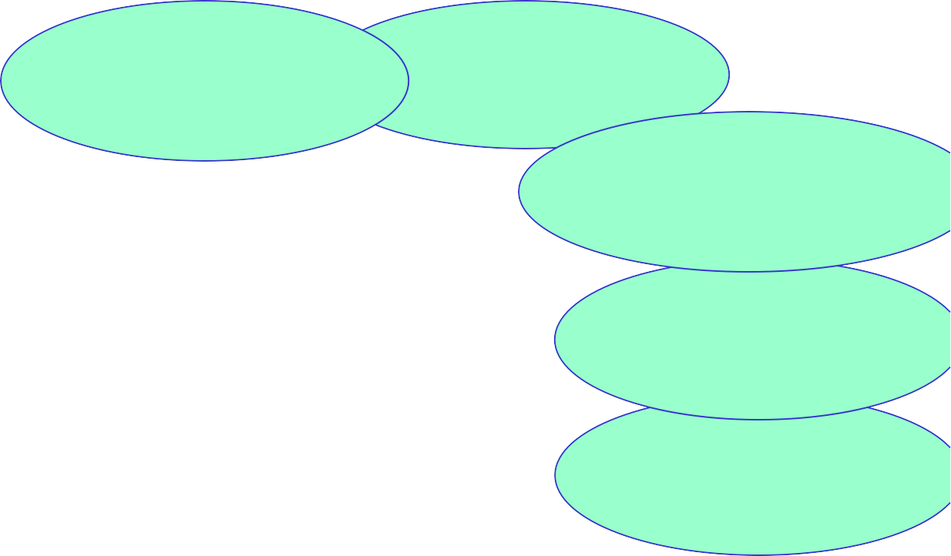




Inventory of Devices
Inventory of
Software
Pentesting
Secure Network Engineering
Incident Response
Data Protection Account Control Need-to-know
Access Control
Monitoring of Audit Logs
Boundary
Defence
Controlled Administrative
Security
Configuration for Devices
Vulnerability Assessment
20 Critical Security Controls
Malware Defenses
Application Software Security
Wireless Access Control Data
Recovery Capability
Security Skills
Control of
Privileges
Network Ports and Protocols
L02 Network
Configuration
Training

Slide 19


Evaluation of the ISMS through Security Measurements
What is the effectiveness of a security control ?
You have to measure it to know it.
Security measurements provide
info about how well security controls work
basis for comparing effect of controls on risks
benchmark for assessing security investments

Slide 20
Why do we care: Example
The CEO asks, “Is our network perimeter secure?”
Without metrics:
“Well, we installed a firewall, so it must be.”
With metrics:
“Yes, our evidence tells us that we are. Look at our intrusion statistics before and after we completed that
firewall project. It’s down 80%. We are definitely more secure today than we were before.”

Slide 21
IS Measurement Model (ISO 27004)
4) Measurement results:
Discover new knowledge
Identify new info needs
Make decisions
Present results
1) Information needs about:
Security Controls
Security Processes
Policy and awareness
Compliance
3) Analyse data:
Manage raw data
Sanitize data
Categorize data
Apply analytical model:
Basic → Derived → Indicator
2) Select data sources and collect relevant data*:
Logs from systems
Questions to people
Observations
Data mining
*) Called Objects of measurement in ISO 27004

Slide 22

Measurement – ISMS integration
Planning
Reporting
Risk sessmt
ISMS
Cycle
Security Controls
Evaluation
Measurement
results
Information
needs
Data
analysis
Data
collection

Slide 23
CMMI
Capability Maturity Model Integration
Considerable effort and time is required to reach each next level in the maturity model.
Managed
5: Optimized / Cultural
4: Managed and measurable 3: Defined processes
2: Repeatable but intuitive processes
Chaotic
1: Initial / Ad Hoc processes
0: No security processes

Slide 24
CMM levels 1 - 3
Initial / Ad Hoc
+ Processes are ad-hoc and disorganised.
+ Risks are considered on an ad hoc basis, but no formal processes exist.
Repeatable but intuitive
+ Processes follow a regular pattern.
+ Emerging understanding of risk and the need for security
Defined process
+ Processes are documented and communicated.
+ Company-wide risk management.’
+ Awareness of security and security policy

Slide 25
CMM levels 4 - 5
Managed and measurable
+ Processes are monitored and measured.
+ Risks assessment standard procedures
+ Roles and responsibilities are assigned
+ Policies and standards are in place
Optimized
+ Security culture permeates organisation
+ Organisation-wide security processes are implemented, monitored and followed

Slide 26

The human factor in information security
Personnel integrity
Making sure personnel do not become attackers
Personnel as defence
Making sure personnel do not fall victim to social engineering attacks
Security usability
Making sure users operate security correctly

Slide 27
Personnel Integrity
Preventing employees from becoming attackers
Consider:
Employees
Executives
Customers
Visitors
Contractors & Consultants
All these groups obtain some form of access privileges
How to make sure privileges are not abused?

Slide 28
Personnel crime statistics
Organisations report that a large proportion of computer
crimes originate from inside
US Statistics (PWC) 2014, 2015, 2016
http://www.pwc.com/us/en/increasing-it-effectiveness/publications/assets/2014-us-state-of-cybercrime.pdf
https://insights.sei.cmu.edu/insider-threat/2017/01/2016-us-state-of-cybercrime-highlights.html
28% had insider attacks, 32% very concerned about insider threats
Australian Statistics (CERT Australia) 2015
http://apo.org.au/research/cyber-crime-and-security-survey-report-2013
14% had insider attacks, 60% very concerned avout insider threats

Slide 29
Strengthening employee integrity
Difficult to determine long term integrity of staff at hiring
Integrity can change, influenced by events
All personnel should follow security awareness training
Reminders about security policy and warnings about consequences of intentional breach of policy
Will strengthen power of judgment
Personnel in highly trusted positions must be supported, trained and monitored
Support and monitor employees in difficult situations:
conflict, loss of job, personal problems
Stay on good terms with staff leaving the company !

Slide 30
Personnel Departure
Different reasons for departure
Voluntary
Redundancy
Termination
Different types of actions
Former employee may keep some privileges
Revoke all privileges
Escort to the exit.
During exit interview, terms of original employment agreement reviewed (i.e. non-compete, wrongful disclosure, etc.

Slide 31
Social engineering attacks
Where people are the defence

Slide 32
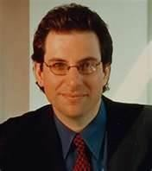
Social Engineering Attacks
According to Kevin Mitnick:
“The biggest threat to the security of a company is not a computer virus, an unpatched hole in a program, or a badly installed firewall. In fact the biggest threat could be you.”
“What I found personally to be true was that it’s easier to manipulate people rather than technology. Most of the time, organisations overlook that human element”.
From “How to hack people”, BBC NewsOnline, 14 Oct 2002

Slide 33
SE Tactics: Develop Trust
People are naturally helpful and trusting
Ask during seemingly innocent conversations
Slowly ask for increasingly important information
Learn company lingo, names of key personnel, names of servers and applications
Cause a problem and subsequently offer your help to
fix it (aka. reverse social engineering)
Talk negatively about common enemy
Talk positively about common hero

Slide 34
SE Tactics: Induce strong affect
Heightened emotional state makes victim
Less alert
Less likely to analyse deceptive arguments
Triggered by attacker by creating
Excitement (“you have won a price”)
Fear (“you will lose your job”)
Confusion (contradictory statements)

Slide 35
SE Tactics: Information overload
Reduced the target’s ability to scrutinize arguments proposed by the attacker
Triggered by
Providing large amounts of information to produce sensory overload
Providing arguments from an unexpected angle, which forces the victim to analyse the situation from new perspective, which requires additional mental processing

Slide 36
SE Tactics: Reciprocation
Exploits our tendency to return a favour
Even if the first favour was not requested
Even if the return favour is more valuable
Double disagreement
If the attacker creates a double disagreement, and gives in on one, the victim will have a tendency to give in on the other
Expectation
If the victim is requested to give the first favour, he will believe that the attacker becomes a future ally

Slide 37
SE Tactics:
Diffusion of responsibility and moral duty
Make the target feel the he or she will not be held responsible for actions
Make the target feel that satisfying attacker’s request is a moral duty

Slide 38
SE Tactics: Authority
People are conditioned to obey authority
Milgram and other experiments
Considered rude to even challenge the veracity of authority claim
Triggered by
Faking credentials
Faking to be a director or superior
Skilful acting (con artist)

Slide 39
SE Tactics: Commitment creep
People have a tendency to follow commitments, even when recognising that it might be unwise.
It’s often a matter of showing personal consistency and integrity
Triggered e.g. by creating a situation where one commitment naturally or logically follows another.
First request is harmless
Second request causes the damage

Slide 40



Multi-Level Defence against Social Engineering Attacks
Offensive Level
Incident Response
Gotcha Level
Social Engineering Detectors
Persistence Level
Ongoing Reminders
Fortress Level
Resistance Training for Key Personnel
Awareness Level
Security Awareness Training for all Staff
Foundation Level
Security Policy to Address SE Attacks
Source: David Gragg: http://www.sans.org/rr/whitepapers/engineering/

Slide 41
SE Defence: Foundation
The security policy must address SE attacks
Policy is always the foundation of information security
Address e.g.: Shredding, Escorting, Authority obedience
Ban practice that is similar to social attack patterns
Asking for passwords over phone is a typical SE attack method
→ Therefore never provide passwords over the phone
Calling a user and pretending to represent IT department is a typical SE attack
→ Therefore never call user, or make it possible/mandatory for user to authenticate the IT Department
Calling IT dep. and pretending to be user is a typical SE attack
→ Therefore make it possible/mandatory for IT department to authenticate the user

Slide 42
SE Defence: Awareness
Security awareness training for all staff
Understanding SE tactics
Learn to recognise SE attacks
Know when to say “no”
Know what is sensitive
Understand their responsibility
Understand the danger of casual conversation
Friends are not always friends
Passwords are personal
Uniforms are cheap
Awareness of policy shall make personnel feel that the only choice is to resist SE attempts

Slide 43
SE Defence: Fortress
Resistance training for key personnel
Consider: Reception, Help desk, Sys.Admin., Customer service,
Fortress training techniques
Inoculation
Expose to SE arguments, and learn counterarguments
Forewarming
of content and intent
Reality check:
Realising own vulnerability,

Slide 44
SE Defence: Persistence
Ongoing reminders
SE resistance will quickly diminish after a training session
Repeated training
Reminding staff of SE dangers
Posters
Messages
Tests

Slide 45
SE Defence: Gotcha
Social Engineering Detectors
Filters and traps designed to expose SE attackers
Consider:
The justified Know-it-all
Person who knows everybody
Centralised log of suspicious events
Can help discover SE patterns
Call backs mandatory by policy
Key questions, e.g. personal details
“Please hold” mandatory by policy
Time to think and log event
Deception
Bogus question
Login + password of “alarm account” on yellow sticker

Slide 46
SE Defence: Offensive
Incident response
Well defined process for reporting and reacting to
Possible SE attack events,
Cases of successful SE attacks
Reaction should be vigilant and aggressive
Go after SE attacker
Proactively warn other potential victims

Slide 47
Security awareness training
Back up and protection of work related information
Passwords
Email and web hygiene and acceptable use
Recognising social engineers
Recognising and reporting security incidents
Responsibilities and duties for security
Consequences of negligence or misbehaviour
Security principles for system and business processes

Slide 48
Security Usability

Slide 49
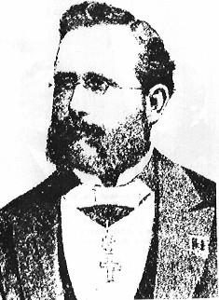
Kerckhoffs - 1883
The father of security usability
Auguste Kerckhoffs. La cryptographie militaire.
Journal des sciences militaires, IX(38):5-38, 1883.
Most famous for “don’t do security by obscurity”
Also defined security usability principles
It must be easy to communicate and remember the keys without requiring written notes, it must also be easy to change or modify the keys with different participants.
Finally, regarding the circumstances in which such a system is applied, it must be easy to use and must neither require stress of mind nor the knowledge of a long series of rules.

Slide 50
Security Learning
Good metaphors are important for learning
Many security concepts do not have intuitive metaphors
Better avoid metaphors than use bad ones
Define new security concepts
and give them semantic content
Security learning design
Design systems to facilitate good security learning
Largely unexplored field

Slide 51
Stages of security learning (Security is often more complicated than you think)
“This is far more complex than I
first thought. I actually don’t think this can ever be made secure.”
3.
Expert and
disillusioned
2.
Educated and optimistic
“I understand it now, it’s simple, and I know how to operate it”
1.
“I don’t understand it, and I don’t want to know about it. Why can’t security simply be transparent?”
Unaware and disinterested

Slide 52
Remarks on security usability
Security usability is difficult to get right
Not the same as IT usability
Security can never be made 100% transparent
Security learning is needed, but a challenge
Security decisions often made without basis
Better support for security decisions is needed
Knowledge about security usability is available
User-friendly security can be designed

Slide 53
End of Lecture

